Slide 1
Chapter 6 – Architectural Design
By Ian Sommerville

Slide 2
Topics covered
Architectural design decisions
Architectural views
Architectural patterns
Application architectures

Slide 3
Software architecture:
Software architecture is the fundamental design of the entire software system.
It defines what elements are included in the system,
what function each element has,
and how each element relates to one another.
In short, it is the big picture or overall structure of the whole system,
how everything works together.
Let's compare this to designing a skyscraper

Slide 4
Agility and architecture
It is generally accepted that an early stage of agile processes is to design an overall systems architecture.
Refactoring the system architecture is usually expensive because it affects so many components in the system

Slide 5
The architecture of a packing robot control system

Slide 6
Architectural abstraction
Architecture in the small is concerned,
with the architecture of individual programs.
At this level, we are concerned with the way that an individual program is decomposed into components.
Example: function call in C Program.
Architecture in the large is concerned,
with the architecture of complex enterprise systems that include other systems, programs, and program components.
These enterprise systems are distributed over different computers, which may be owned and managed by different companies.

Slide 7
Advantages of explicit architecture
Stakeholder communication
Architecture may be used as a focus of discussion by system stakeholders.
System analysis
Means that analysis of whether the system can meet its non-functional requirements is possible.
Large-scale reuse
The architecture may be reusable across a range of systems
Product-line architectures may be developed.

Slide 8
Architectural representations
Informal block diagrams showing entities and relationships are the most frequently used method for documenting software architectures.
But these have been criticized,
Because they lack semantics,
Do not show the types of relationships between entities
Nor the visible properties of entities in the architecture.

Slide 9
Box and line diagrams
Very abstract - they do not show the nature of component relationships nor the externally visible properties of the sub-systems.
However, useful for communication with stakeholders and for project planning.

Slide 10
Use of architectural models
As a way of facilitating discussion about the system design
A high-level architectural view of a system is useful for communication with system stakeholders and project planning because it is not cluttered with detail.
As a way of documenting an architecture that has been designed
The aim here is to produce a complete system model that shows the different components in a system, their interfaces and their connections.

Slide 11
Architectural design decisions

Slide 12
Architectural design decisions
Architectural design is a creative process so the process differs depending on the type of system being developed.
However, a number of common decisions span all design processes and these decisions affect the non-functional characteristics of the system.

Slide 13
Architectural design decisions

Slide 14
Architecture reuse
Systems in the same domain often have similar architectures that reflect domain concepts.
Application product lines are built around a core architecture with variants that satisfy particular customer requirements.
The architecture of a system may be designed around one of more architectural patterns or ‘styles’.

Slide 15
Architecture and system characteristics
Performance
Localize critical operations and minimize communications.
Use large rather than fine-grain components.
Security
Use a layered architecture with critical assets in the inner layers.
Safety
Localize safety-critical features in a small number of sub-systems.
Availability
Include redundant components and mechanisms for fault tolerance.
Maintainability
Use fine-grain, replaceable components.

Slide 16
Architectural views

Slide 17
Architectural views
Each architectural model only shows one view or perspective of the system.
It might show how a system is decomposed into modules, how the run-time processes interact or the different ways in which system components are distributed across a network. For both design and documentation, you usually need to present multiple views of the software architecture.

Slide 18
Architectural views

Slide 19
4 + 1 view model of software architecture
A logical view focuses,
On achieving functional requirements of a system
Services of the system
The key abstractions in the system as objects or object classes.
A process view, which shows how, at run-time, the system is composed of interacting processes. Like sequence diagram and activity diagram.

Slide 20
4 + 1 view model of software architecture
A development view, which shows how the software is decomposed for development.
A physical view, which shows the system hardware and how software components are distributed across the processors in the system.
Related using use cases or scenarios (+1)

Slide 21
Representing architectural views
Some people argue that the Unified Modeling Language (UML) is an appropriate notation for describing and documenting system architectures
I disagree with this as I do not think that the UML includes abstractions appropriate for high-level system description.

Slide 22
Architectural patterns

Slide 23
Architectural patterns
Patterns are a means of representing, sharing and reusing knowledge.
An architectural pattern is a stylized description of good design practice, which has been tried and tested in different environments.
Patterns should include information about when they are and when the are not useful.
Patterns may be represented using tabular and graphical descriptions.

Slide 24
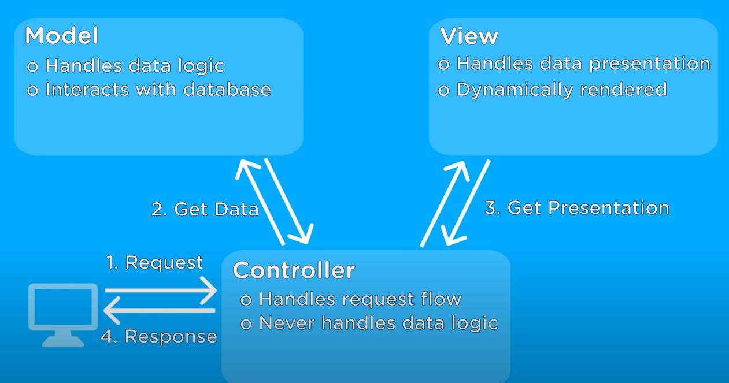
The Model-View-Controller (MVC) pattern

Slide 25
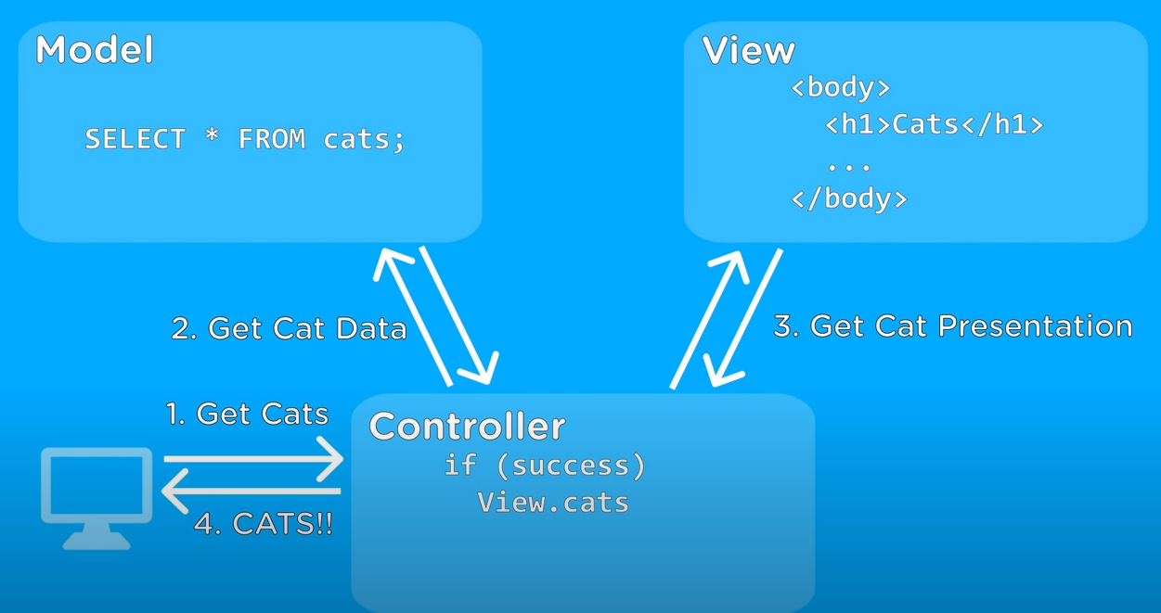
The Model-View-Controller (MVC) pattern
The goal of this pattern is to split a large application into specific section that has its own purpose.

Slide 26
The organization of the Model-View-Controller

Slide 27
Web application architecture using the MVC pattern

Slide 28
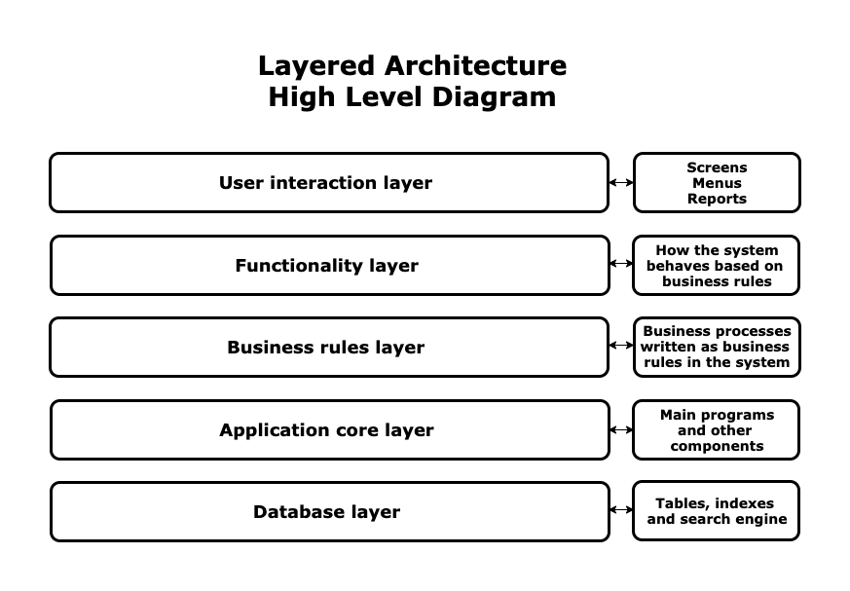
Layered architecture

Slide 29
The Layered architecture pattern
As you can see in the diagram above, a standard layered architecture has five parts:
User interaction layer: This is the layer that interacts with users through screens, forms, menus, reports, etc. It is the most visible layer of the application. It defines how the application looks.
Functionality layer: This is the layer that presents the functions, methods, and procedures of the system based on the business rules layer. It determines how the pull-down menus work, how the buttons work, and how the system navigates through screens.
Business rules layer: This layer contains rules that determine the behavior of the whole application, such as, “If an invoice is printed, then send an email to the customer, select all items sold, and decrease their stock in the stock management module.”
Application core layer: This server contains the main programs, code definitions, and basic functions of the application. Programmers work in this layer most of the time.
Database layer: This layer contains the tables, indexes, and data managed by the application. Searches and insert/delete/update operations are executed here.

Slide 30
The architecture of the iLearn system

Slide 31
Repository architecture
Data is stored in a central shared repository.
• Components interact through the repository only.
• Suited to applications whose data is generated by one component and used by another.
• Advantages: -
Components are independent/separate.
Changes to data are automatically available to other components.
• Communication between components may be inefficient

Slide 32
A repository architecture for an IDE

Slide 33
Client-server architecture
Front-End: This is the piece of software that interacts with users, even if they are on different platforms with different technologies. Any front-end module in a client-server architecture is designed to interact with all existing devices on the market. This level contains the login screens, menus, data screens.
Application server: This is the server where the software modules of the application are installed. It connects to the database (called back-end) and interacts with users (called front-end). The application server is like the waiter on our restaurant example.
Database server: This server contains the tables, indexes, and data managed by the application. Searches and insert/delete/update operations are executed here.

Slide 34
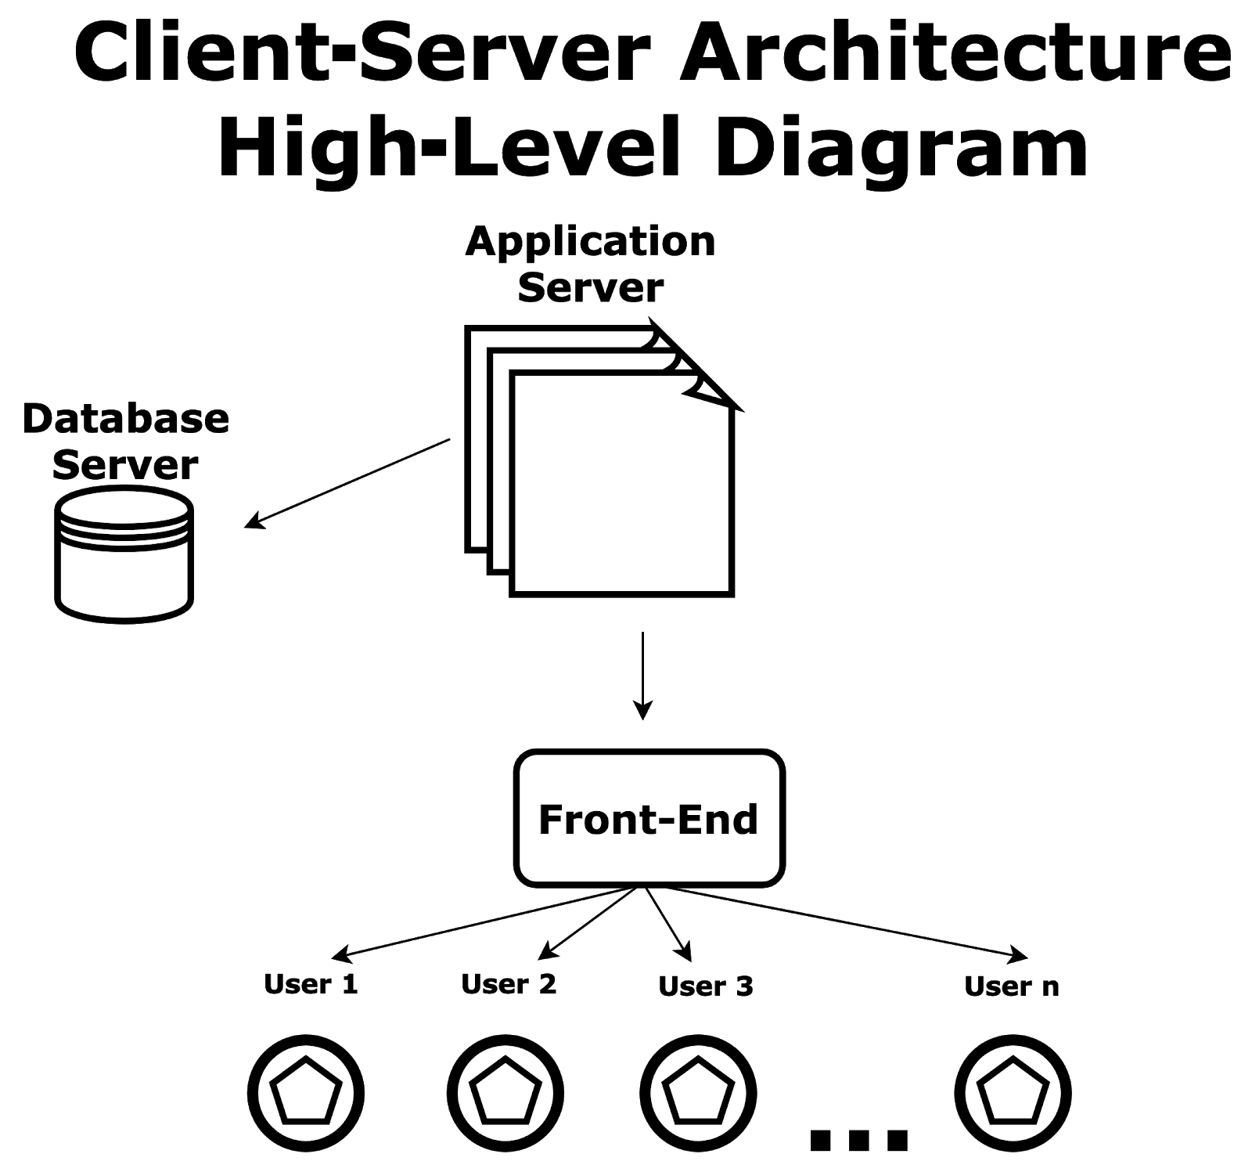
A client–server architecture for a film library

Slide 35
Pipe and filter architecture
Functional transformations process their inputs to produce outputs.
Variants of this approach are very common. When transformations are sequential, this is a batch sequential model which is extensively used in data processing systems.
Not really suitable for interactive systems.

Slide 36
An example of the pipe and filter architecture used in a payments system

Slide 37
Application architectures

Slide 38
Application architectures
Application systems are designed to meet an organizational need.
As businesses have much in common, their application systems also tend to have a common architecture that reflects the application requirements.
A generic application architecture is an architecture for a type of software system that may be configured and adapted to create a system that meets specific requirements.

Slide 39
Use of application architectures
As a starting point for architectural design.
As a design checklist.
As a way of organising the work of the development team.
As a means of assessing components for reuse.
As a vocabulary for talking about application types.

Slide 40
Examples of application types
Data processing applications
Data driven applications that process data in batches without explicit user intervention during the processing.
Transaction processing applications
Data-centred applications that process user requests and update information in a system database.
Event processing systems
Applications where system actions depend on interpreting events from the system’s environment.
Language processing systems
Applications where the users’ intentions are specified in a formal language that is processed and interpreted by the system.

Slide 41
Application type examples
Two very widely used generic application architectures are transaction processing systems and language processing systems.
Transaction processing systems
E-commerce systems;
Reservation systems.
Language processing systems
Compilers;
Command interpreters.

Slide 42
Transaction processing systems
Process user requests for information from a database or requests to update the database.
From a user perspective a transaction is:
Any coherent sequence of operations that satisfies a goal;
For example - find the times of flights from London to Paris.
Users make asynchronous requests for service which are then processed by a transaction manager.

Slide 43
The structure of transaction processing applications

Slide 44
The software architecture of an ATM system

Slide 45
Information systems architecture
Information systems have a generic architecture that can be organised as a layered architecture.
These are transaction-based systems as interaction with these systems generally involves database transactions.
Layers include:
The user interface
User communications
Information retrieval
System database

Slide 46
Layered information system architecture

Slide 47
The architecture of the Mentcare system

Slide 48
Web-based information systems
Information and resource management systems are now usually web-based systems where the user interfaces are implemented using a web browser.
For example, e-commerce systems are Internet-based resource management systems that accept electronic orders for goods or services and then arrange delivery of these goods or services to the customer.
In an e-commerce system, the application-specific layer includes additional functionality supporting a ‘shopping cart’ in which users can place a number of items in separate transactions, then pay for them all together in a single transaction.

Slide 49
Language processing systems
Accept a natural or artificial language as input and generate some other representation of that language.
May include an interpreter to act on the instructions in the language that is being processed.
Used in situations where the easiest way to solve a problem is to describe an algorithm or describe the system data

Slide 50
The architecture of a language processing system

Slide 51
Compiler components
A lexical analyzer, which takes input language tokens and converts them to an internal form.
A symbol table, which holds information about the names of entities (variables, class names, object names, etc.) used in the text that is being translated.
A syntax analyzer, which checks the syntax of the language being translated.
A syntax tree, which is an internal structure representing the program being compiled.

Slide 52
Compiler components
A semantic analyzer that uses information from the syntax tree and the symbol table to check the semantic correctness of the input language text.
A code generator that ‘walks’ the syntax tree and generates abstract machine code.

Slide 53
A repository architecture for a language processing system

Slide 54
A pipe and filter compiler architecture

Slide 55
Key points
A software architecture is a description of how a software system is organized.
Architectural design decisions include decisions on the type of application, the distribution of the system, the architectural styles to be used.
Architectures may be documented from several different perspectives or views such as a conceptual view, a logical view, a process view, and a development view.
Architectural patterns are a means of reusing knowledge about generic system architectures. They describe the architecture, explain when it may be used and describe its advantages and disadvantages.

Slide 56
Key points
Models of application systems architectures help us understand and compare applications, validate application system designs and assess large-scale components for reuse.
Transaction processing systems are interactive systems that allow information in a database to be remotely accessed and modified by a number of users.
Language processing systems are used to translate texts from one language into another and to carry out the instructions specified in the input language. They include a translator and an abstract machine that executes the generated language.

